Slide 1
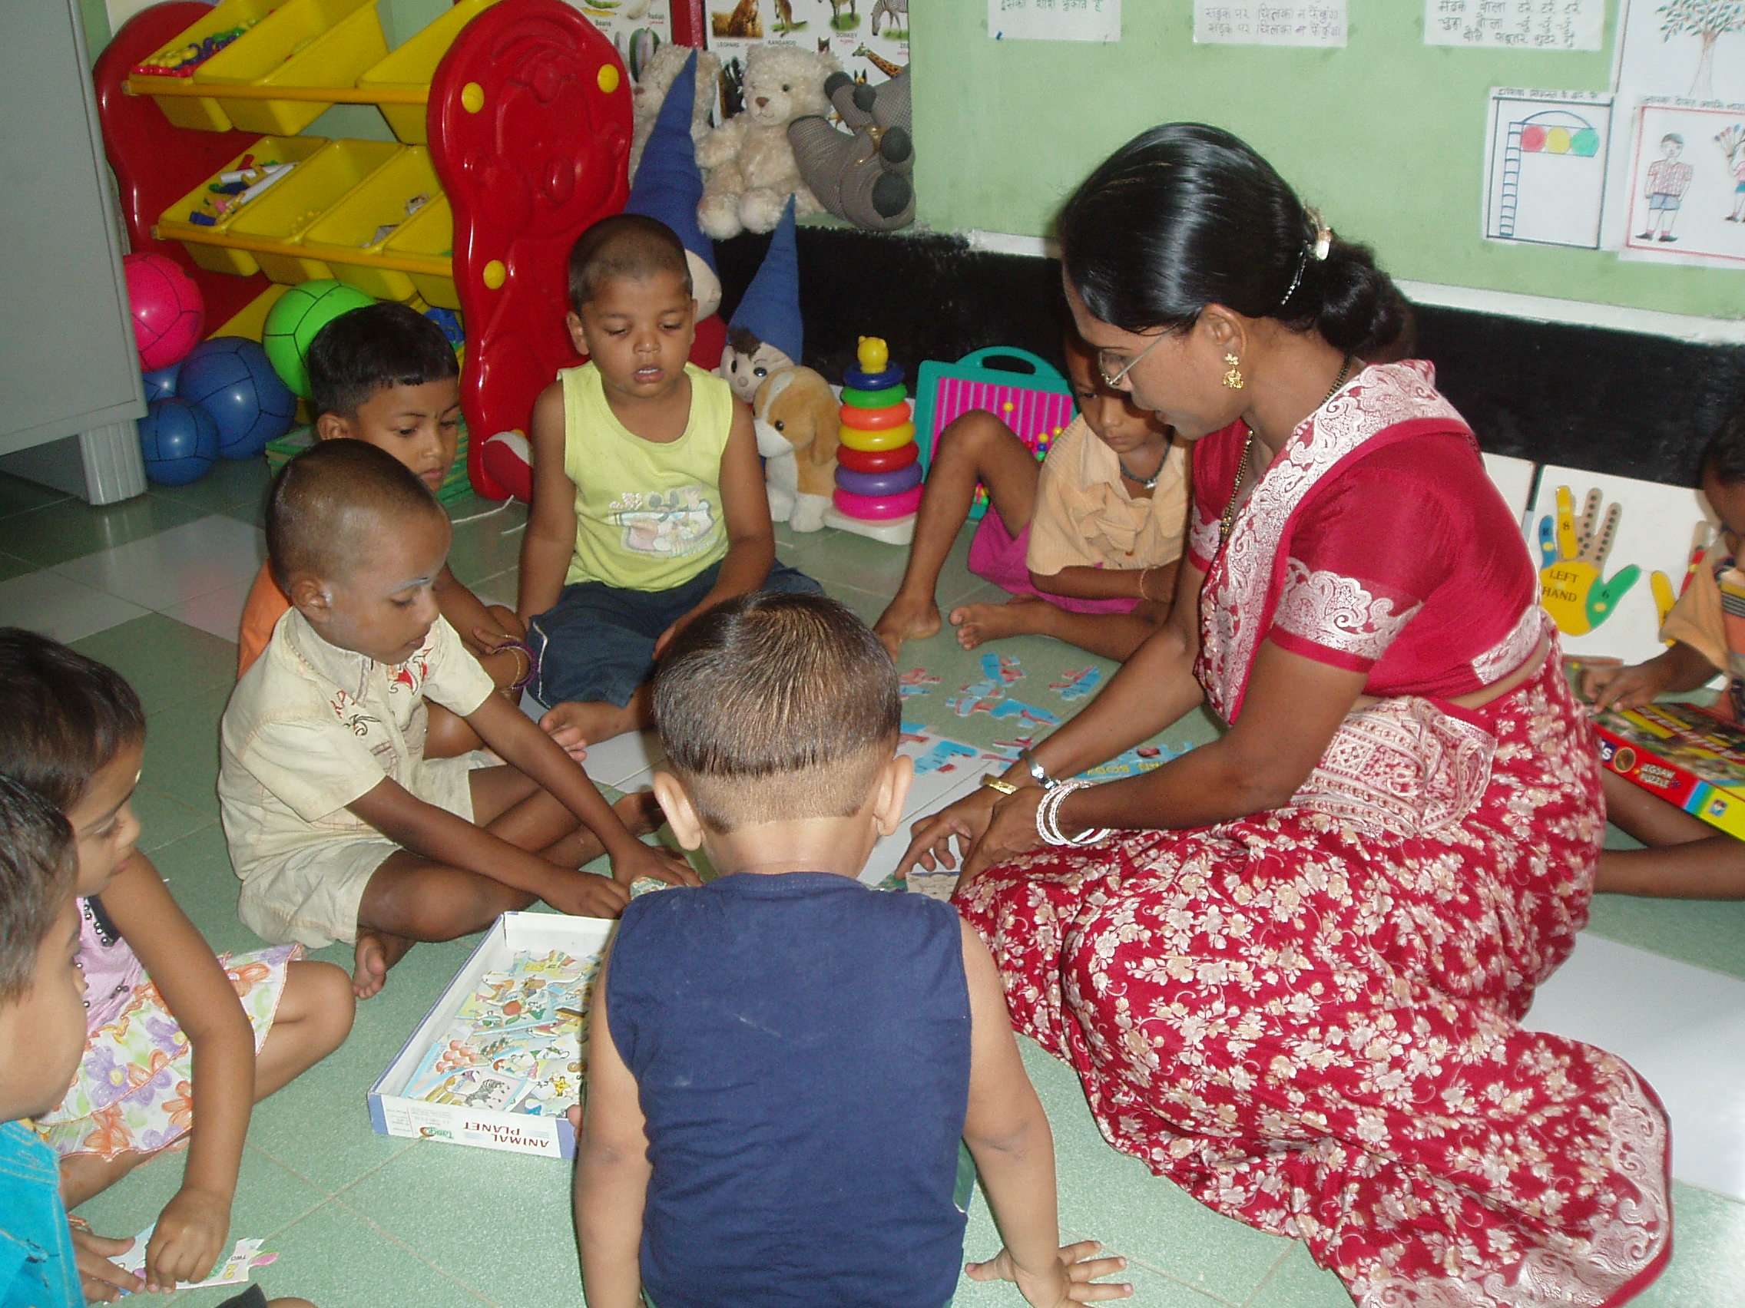
ECCE Policy in India: Process, Promise and Prospects Venita Kaul
Venita Kaul
“
The early years of a child’s life last a lifetime……’“
Venita Kaul

Slide 2
Roadmap
ECCE: The Indian Context
ECCE in context of RTE(2009)
ECCE Policy ( 2012)
The Process
The Commitments
The Challenges
Role of Higher learning Institutions
CECED

Slide 3
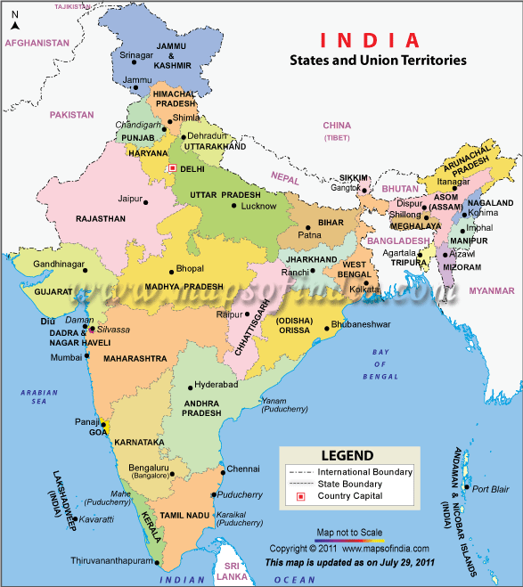
Federal Structure of India

Slide 4
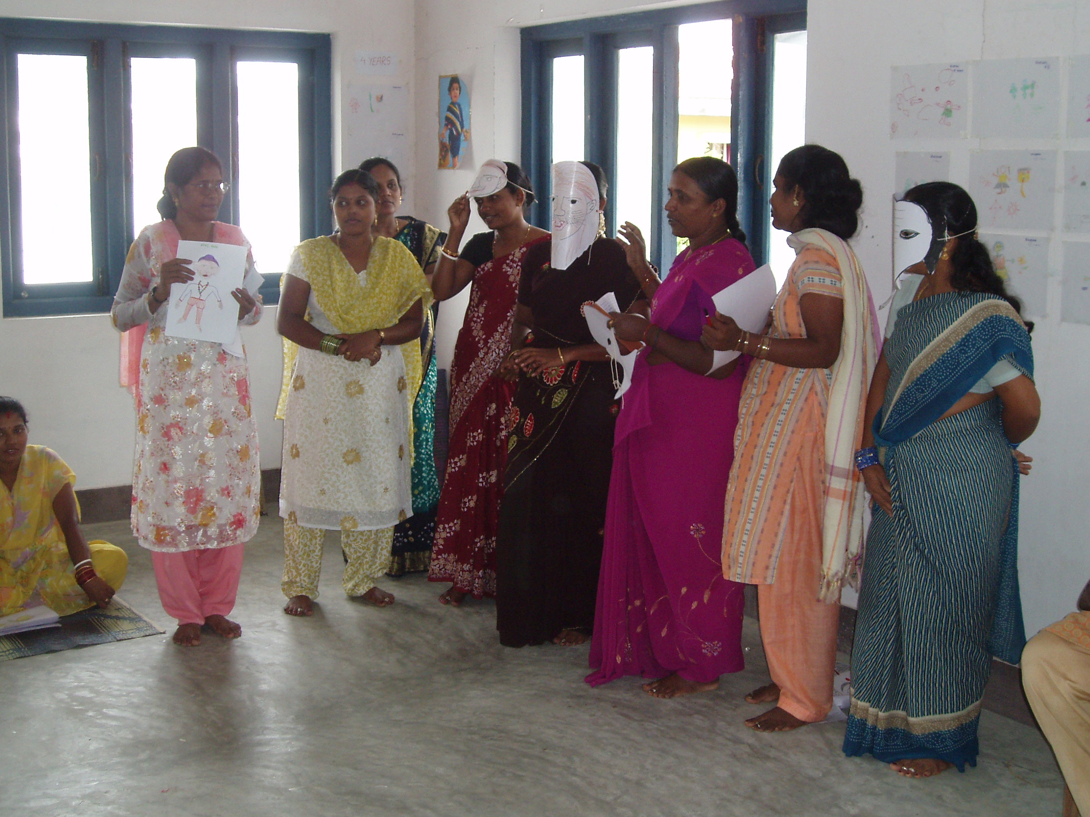
About India-Challenges?
Scale
Population: 1.2 billion(2011)
1/6 of world’s population.
More than 50 % below 25
Below 6 years: 159 million(2011)
Literacy rate : 74.04%;
29 States and UTs
Diversity:
Ethnic groups: 2000
Languages: 29
Religions : all represented
Social indicators:
IMR: 30.1
Under 5 mortality: 48
Malnutrition 45%
Low birth weight :28
Immunization by year 1: 87%
NER (ELEM) : About 90
GER (ECE) : Over 65%

Slide 5
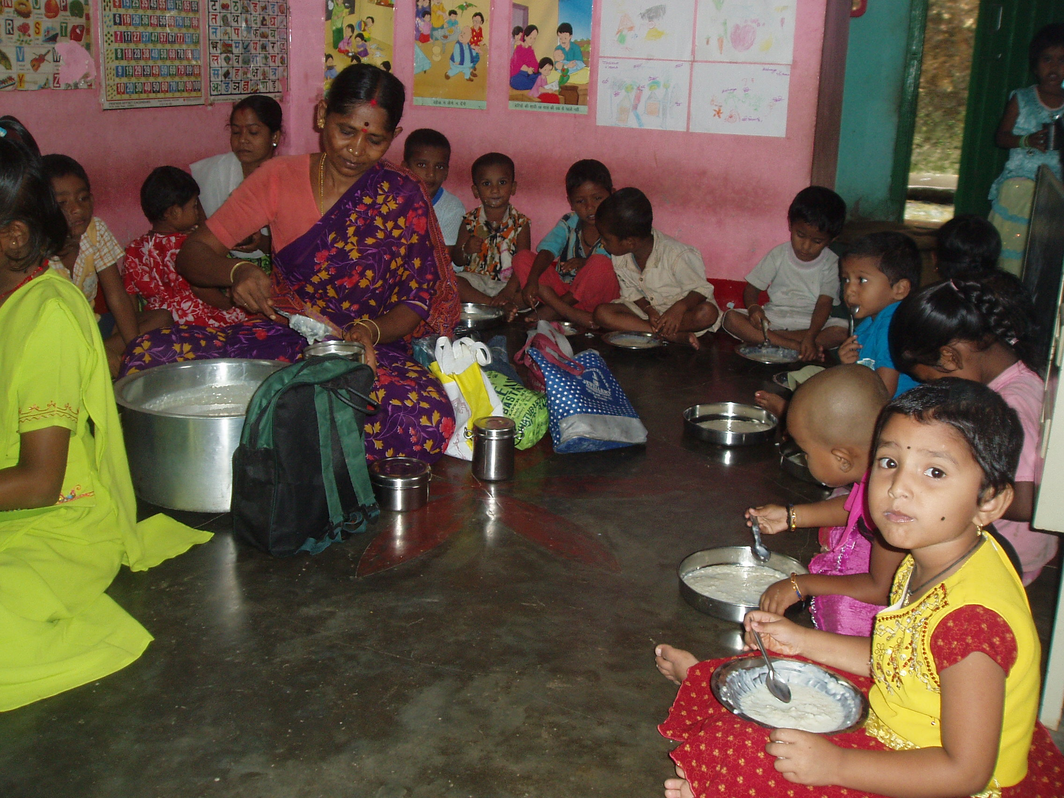
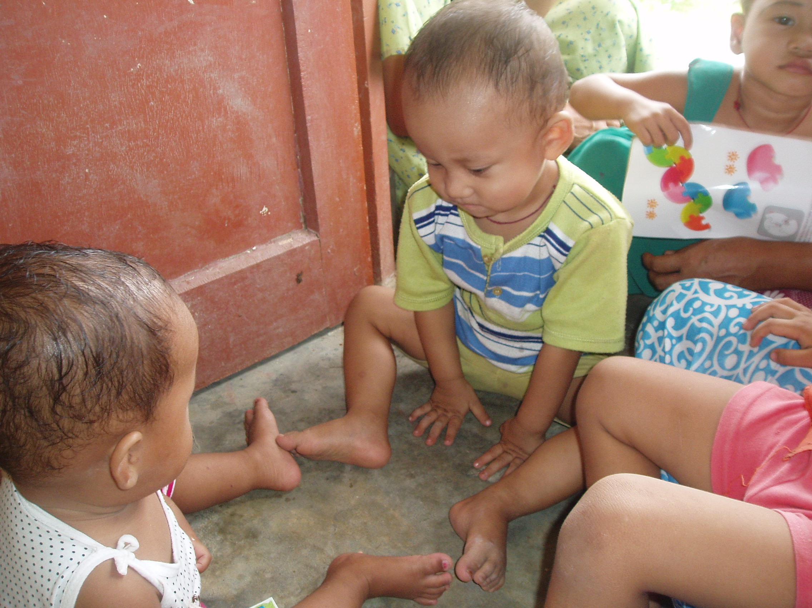
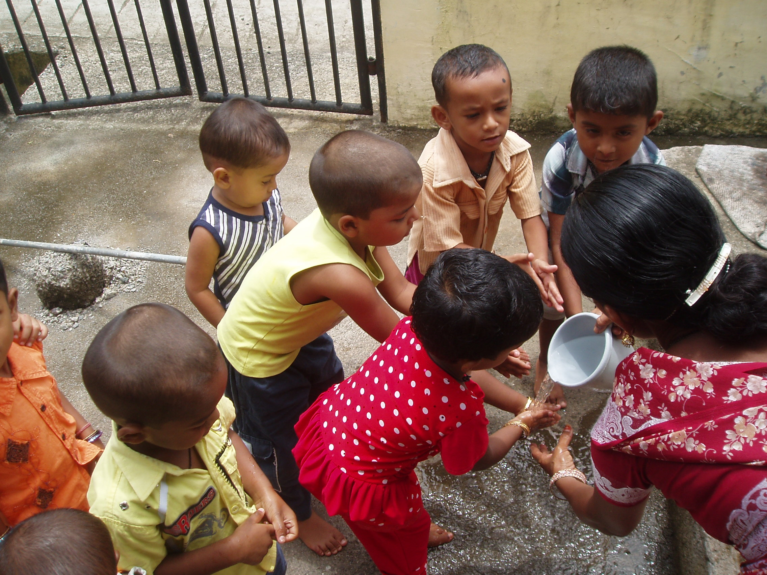
Concept of ECCE in India
ECCE/ECD is defined as care, nutrition, health and education provisions for children from prenatal to six/eight years of age which promote their holistic and integrated development. Nodal Ministry: Women & Child Development. Transferred from MHRD

Slide 6
8 -11yrs
Completion of primary education and gain of improved life chances.
(Classes 3-5)
6-8yrs
Adjustment to formal school and learning of 3 R;s while maintaining good health
(Classes 1-2)
3-6 yrs
Socialization, psychosocial interaction, play, and readiness for school and good health habits through ECCE.
1 month-3yrs
Nutrition security,immunization
and Early Stimulation and Care.
Prenatal-1 month
Survival care and protection
of newborn.

Slide 7
ECCE in context of RTE ( 2009): Goals
Every child 6-14 years enrolled in and attending school. Enrolled but attending??
Every child remains in school. Drop outs are still high!
Every child completes elementary education with appropriate learning levels. Learning levels sliding, not improving !!
RIGHT TO SCHOOLING OR EDUCATION??
FOCUS NEEDED ON THE CHILD!

Slide 8
Research showing Significance of ECCE for EFA goals
Indian research:
Children’s retention in primary grades improves by 15-20 percent if they have gone through ECCE.
Children’s Attendance improves significantly.
Children’s learning improves eg. maths learning improved even till grade 5 ; improvement in reading and language skills.
Children are not school ready!! (IECEI study)
Western research : higher incomes & incidence of home ownership, lower propensity to be on welfare and lower rates of crime and arrest.
But Quality of ECCE essential.

Slide 9
WHY ECCE? Evidence from Neuro -Science
The brain growth curve

Slide 10
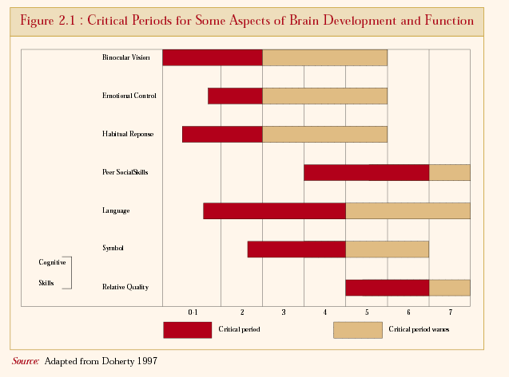
Evidence from Neuro-Science

Slide 11
India has an established policy and programmatic framework for ECCE. But there are challenges.

Slide 12
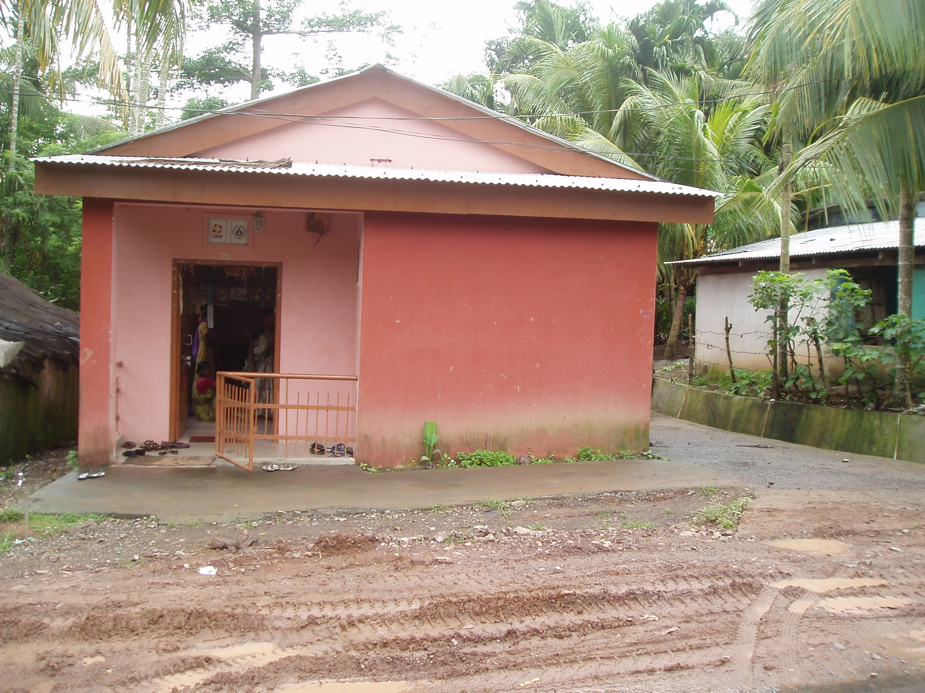
Integrated Child Development Services ( ICDS)
Program Design
Inception in 1975 for pregnant and lactating women, adolescent girls and children under 6 year, using a life cycle approach.
Every habitation in India has an ECD center: ‘anganwadi’ –”courtyard center’ with 1 AWW and a helper.
Six Services:
Immunization
Supplementary nutrition
Health checkup
Referral services
Pre-school non formal education
Nutrition and Health education
Status of ICDS (2011)
Total AWCs : 1.4 million
Total beneficiaries:179 million:
Children 3 – 6 years for pre-school non –formal education: 34.7million.

Slide 13
Policies for Early Childhood in India
National Policy on Education ( 1986) acknowledges integrated Early childhood as the foundation stage. NO FORMAL 3 R’s!
National Policy for Children ( 1974, now under revision ) “State to provide adequate services to children, both before and after birth and throughout the period of growth - to ensure their full physical, mental and social development”
Right of Children to Free and Compulsory Education Act (2009) states, “with a view to prepare children above the age of three years for elementary education and to provide ECCE, appropriate Governments may make necessary arrangements for providing free pre -school education for such children” .
Constitution of India (Amended Article 45) ---“The State shall endeavour to provide ECCE for all children until they complete the age of six years”.

Slide 14
Recent Policy Initiatives in ECCE
MWCD : ICDS
National Policy on ECCE (2013)
National Curriculum Framework-pilots
Quality Standards
ICDS Restructured
MHRD: School Education
RTE Section 11 talks of ‘may make necessary arrangements…”; Article 45 : Endeavour….
CABE sub group for making ECE part of RTE-? Debate on right to ECE or ECD??
12th FYP –Pre primary education and Early learning unit.

Slide 15
National Policy on ECCE : A Participatory Process
Core Group Established of professionals and Civil Society representatives who prepared the draft.
Draft posted on MWCD web site for several weeks to elicit feedback.
Feedback considered and incorporated to make it more integrated and include below 3 years.
Shared with other Ministries and Planning Commission.
Approved and Notified in September 2013.

Slide 16
National Policy on ECCE : Main Thrust areas
Universal Access with equity and inclusion-mainly through ICDS to (a) reach marginalized children (b) facilitate inclusion of Children with special needs for early identification and intervention© adopt an urban strategy.
Quality in ECCE: (a) DAP Curriculum Framework and standards (b) Quality standards for all sectors (accreditation) and © ensure provision of adequate play &learning materials (d) conduct program evaluation and child assessment.

Slide 17
3. Strengthening capacity, monitoring and supervision
(a) ECCE Council at all levels, national to sub- district.
(b) Professionalization of ECCE sector at all levels
(c) Strengthening training &supportive supervision/monitoring based on monitoring framework
(d) increased quality in spending for child well being;
(e) establishing partnerships—Community, PPP, etc.

Slide 18
ICDS Restructured
ECCE centers repositioned as “vibrant ECD centers” as first village outpost with adequate human resource and infrastructure for ensuring continuum of care and learning.
4 hours of ECE daily –move away from “khichri center” .
Celebration of Monthly ECCE DAY
Early Stimulation emphasized along with nutrition and health, with provision for care and nutrition counseling. services for mothers of children below 3 years.
5 percent Aws to be extended to AW cum creches;

Slide 19
ECE in Focus now--- But many challenges ahead..
Lack of institutional capacity to plan, implement and monitor ECCE at all levels.
Lack of parental awareness regarding developmentally appropriate ECCE.
Unregulated and expanding private sector with corporal punishment, rote learning and poor quality ECE.
Poor infrastructure and human resources for service delivery.
Lack of professionalism in addressing ECCE. Very limited trained human resource at all levels.
No data base in ECCE

Slide 20
Advocacy, research and review : Role of HL Institutions
Supporting & conducting research to generate indigenous knowledge and evidence based advocacy for Developmentally appropriate ECE programs.
Advocacy with stakeholders including policy makers, parents, service providers towards enabling them to involve in and advocate for better planning, implementation and monitoring of ECCE programs.
Voluntary Action Groups and Resource Networks for supporting reform.
Development of capable leaders in ECCE.
Need for involvement of higher learning institutions.
Center for Early Childhood Education and Development (CECED) at Ambedkar University Delhi: a case in point……………………

Slide 21
CECED’s Aims and Objectives
Promote systemic understanding of dev &contextually appropriate &inclusive ECED with focus on early learning
Expand landscape of indigenous knowledge on ECED &narrow gap between theory, research, policy ,practice.
Strengthen momentum for good quality &play based ECED
Critique &provide evidence based policy related advice &feedback on existing programs &provisions across sectors

Slide 22
CECED Functions
Documentation, Knowledge Creation and theory building through longitudinal, multi-disciplinary & multi-centric research
Technical resource for quality promotion and related capacity building
Clearing house and repository of information/ data on ECED

Slide 23
Research
IECEI Study Longitudinal Study
Teacher Education Survey
Impact Evaluation of Early Stimulation of infants
Program Evaluations

Slide 24
Quality Promotion
M A ECCE
Technical support
Early learning Standards
Policy briefs

Slide 25
Advocacy and Networking
ANNUAL CONFERENCES
Quarterly seminars/lectures
WEB PORTAL
Multimedia Series -

Slide 26
Thank You and Look forward to collaborating and working together for ECCE!

